Slide 1
Chapter 4:
Intellectual Property

Slide 2
4.6 Peer-to-Peer Networks and Cyberlockers
1-<number>

Slide 3
Peer-to-Peer Networks
Peer-to-peer network
  Transient network
  Connects computers running same networking program
  Computers can access files stored on each other’s hard drives
How P2P networks facilitate data exchange
  Give each user access to data stored in many other computers
  Support simultaneous file transfers among arbitrary pairs of computers
  Allow users to identify systems with faster file exchange speeds
1-<number>

Slide 4
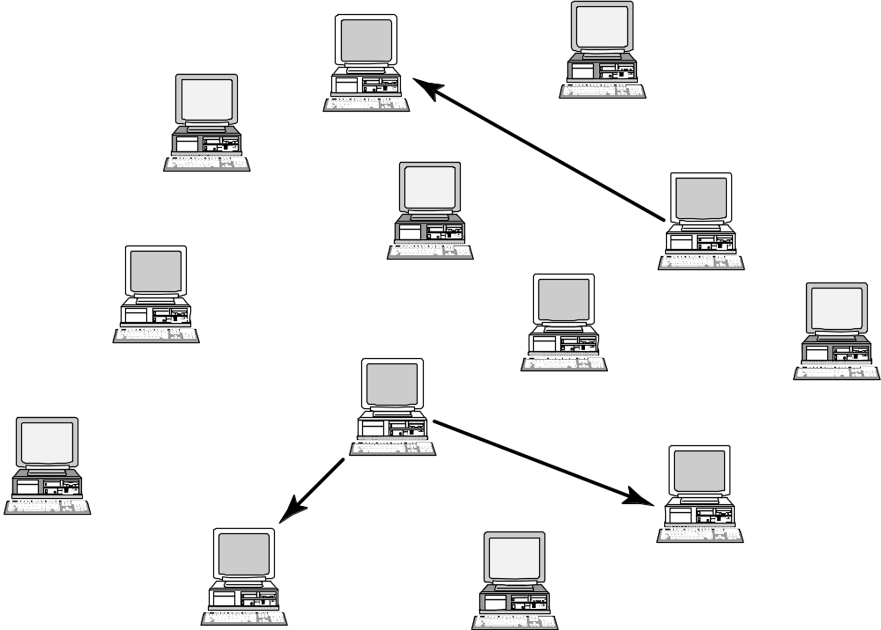
A Peer-to-Peer Network
1-<number>

Slide 5
Cyberlockers
Also called file-hosting services or cloud storage services
Internet-based file-sharing services
Allow users to upload and download password-protected files
Support workgroup collaboration
Make sharing of copyrighted material easy
1-<number>

Slide 6
Napster
Peer-to-peer music exchange network
Began operation in 1999
Sued by RIAA for copyright violations
Courts ruled in favor of RIAA
Went off-line in July 2001
Re-emerged in 2003 as a subscription music service
1-<number>

Slide 7
FastTrack
Second-generation peer-to-peer network technology
Used by KaZaA and Grokster
Distributes index among large number of “supernodes”
Cannot be shut down as easily as Napster
1-<number>

Slide 8
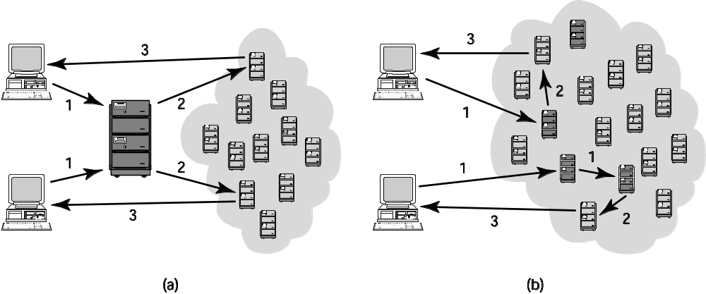
Comparing Napster and FastTrack
1-<number>

Slide 9
BitTorrent
Broadband connections: download much faster than upload
BitTorrent speeds downloading
  Files broken into pieces
  Different pieces downloaded from different computers
Used for downloading large files
  Computer programs
  Television shows
  Movies
1-<number>

Slide 10
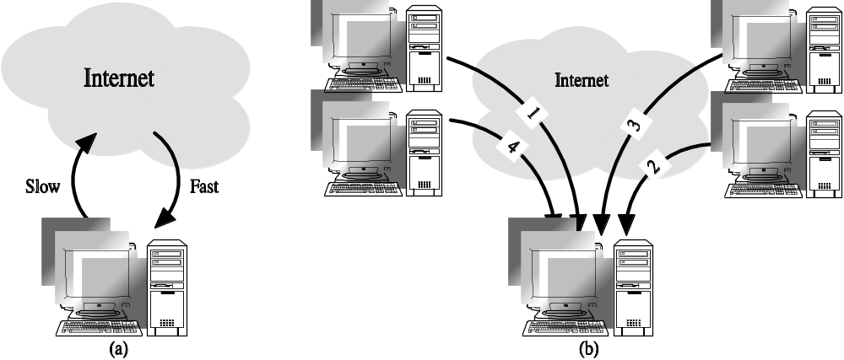
Concept Behind BitTorrent
1-<number>

Slide 11
RIAA Lawsuits
April 2003: RIAA warned file swappers they could face legal penalties
RIAA subpoenaed Verizon for identities of people suspected of running supernodes
Judge ruled in favor of Verizon
September 2003: RIAA sued 261 individuals
December 2003: U.S. Court of Appeals ruled Verizon did not have to give customer names to RIAA
1-<number>

Slide 12
Huge Jury Judgments Overturned
Jammie Thomas-Rassert
  Federal jury ordered her to pay $1.92 million
  Damages reduced to $54,000
Joel Tenenbaum
  Jury ordered him to pay $675,000
  Judge reduced award to $67,500
Does RIAA have to prove someone actually copied the songs that people made available on Kazaa?
  New York decision: No
  Massachusetts, Arizona decisions: Yes
1-<number>

Slide 13
MGM v. Grokster
Entertainment industry interests sued Grokster and StreamCast for the copyright infringements of their users
Lower courts
  Ruled in favor of Grokster and StreamCast
  Cited Sony v. Universal City Studios as a precedent
U.S. Supreme Court
  Reversed the lower court ruling in June 2005
  Proper precedent Gershwin Publishing v. Columbia Artists
1-<number>

Slide 14
Legal Action Against The Pirate Bay
The Pirate Bay started in Stockholm, Sweden
One of world’s biggest BitTorrent file-sharing sites
People download songs, movies, TV shows, etc.
After 2006 raid by police, popularity increased
In 2008 the International Federation of the Phonographic Industry sued four individuals connected with site
Defendants said The Pirate Bay just a search engine
Found guilty; sentence to prison and fined $6.5 million
Meanwhile, The Pirate Bay still operational
More than 150 proxy servers all over the world
1-<number>

Slide 15
PRO-IP Act
Gives federal law enforcement agencies right to seize domain names of sites facilitating copyright infringement
Operation In Our Sites (2010)
  Seized domain names of 10 Web sites making available full-run movies
  Seized several hundred more domain names over next 1 ½ years
1-<number>

Slide 16
Megaupload Shutdown
Megaupload a prominent cyberlocker
  More than 180 million registered users
  Once world’s 13th most popular Web site
  Source of movies, TV shows, songs, games
FBI used PRO-IP Act to shut down Megaupload (January 2012)
FileSonic and FileServe responded by disabling sharing functionality
1-<number>

Slide 17
Legal Music Services on the Internet
Subscription services for legal downloading
Some based on monthly fee; some free
Consumers pay for each download
Apple’s iTunes Music Store leading service, surpassing WalMart as top music retailer in United States
Still, illegal downloading far more popular than legal music services
1-<number>

Slide 18
4.7 Protections for Software
1-<number>

